Slide 1
Boosting
Noble Xavier

Slide 2
Boosting
Boosting is the process that uses a set of Machine Learning algorithms to combine weak learns to form strong learns in order to increase the accuracy of the model
Boosting is an ensemble modeling technique that attempts to build a strong classifier from the number of weak classifiers. It is done by building a model by using weak models in series.
Firstly, a model is built from the training data. Then the second model is built which tries to correct the errors present in the first model. This procedure is continued and models are added until either the complete training data set is predicted correctly or the maximum number of models are added.

Slide 3
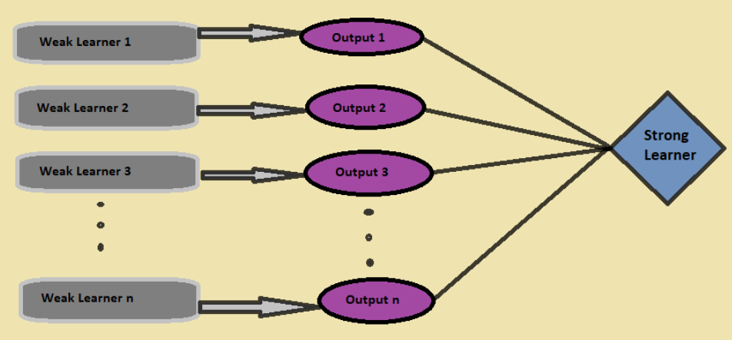
Boosting

Slide 4
Advantages of Boosting
  Improved Accuracy – Boosting can improve the accuracy of the model by combining several weak models’ accuracies and averaging them for regression or voting over them for classification to increase the accuracy of the final model.
  Robustness to Overfitting – Boosting can reduce the risk of overfitting by reweighting the inputs that are classified wrongly.
  Better handling of imbalanced data – Boosting can handle the imbalance data by focusing more on the data points that are misclassified
  Better Interpretability – Boosting can increase the interpretability of the model by breaking the model decision process into multiple processes.

Slide 5
Boosting Algorithms
Adaboost (Adaptive Boosting)
Gradient Boosting
XGBoost (Extreme Gradient Boosting)
CatBoost (Category Boosting)
Light GBM (Light Gradient Boosting Machine)
Stochastic Gradient Boosting
HP Boost (High-Performance Boosting)

Slide 6
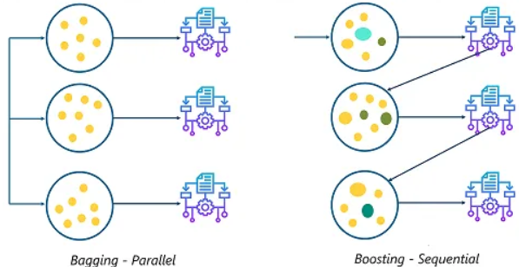
Bagging vs Boosting
Bagging is used in Random Forest, The data set is divided into multiple groups, and then run Decision tree is on each group

Slide 7
Boosting vs Bagging
Boosting | Bagging
In Boosting we combine predictions that belong to different types | Bagging is a method of combining the same type of prediction
The main aim of boosting is to decrease bias, not variance | The main aim of bagging is to decrease variance not bias
At every successive layer Models are weighted according to their performance. | All the models have the same weightage
New Models are influenced by the accuracy of previous Models | All the models are independent of each other

Slide 8
ADA BOOST

Slide 9
Ada Boost
AdaBoost, short for Adaptive Boosting, is an ensemble machine learning algorithm that can be used in a wide variety of classification and regression tasks.
It is a supervised learning algorithm that is used to classify data by combining multiple weak or base learners (e.g., decision trees) into a strong learner.

Slide 10
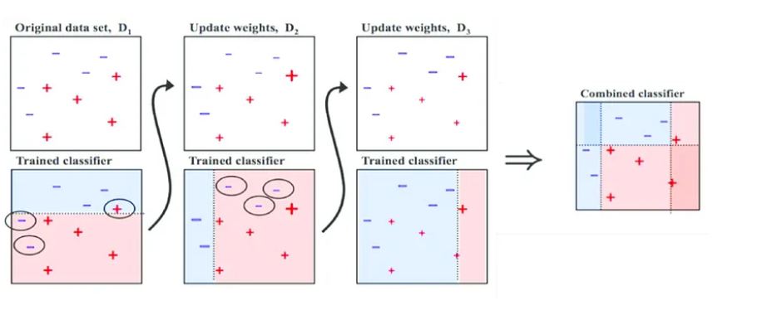
Ada Boost

Slide 11
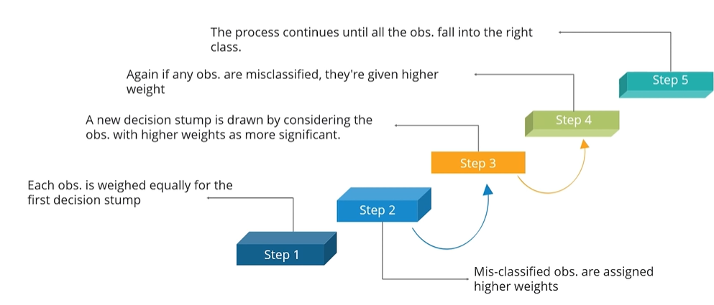
Ada Boost

Slide 12
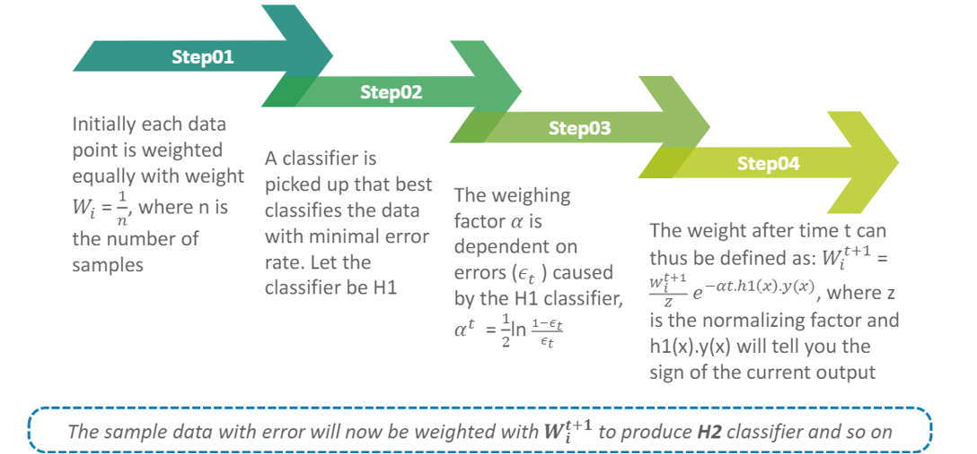
Ada Boost

Slide 13
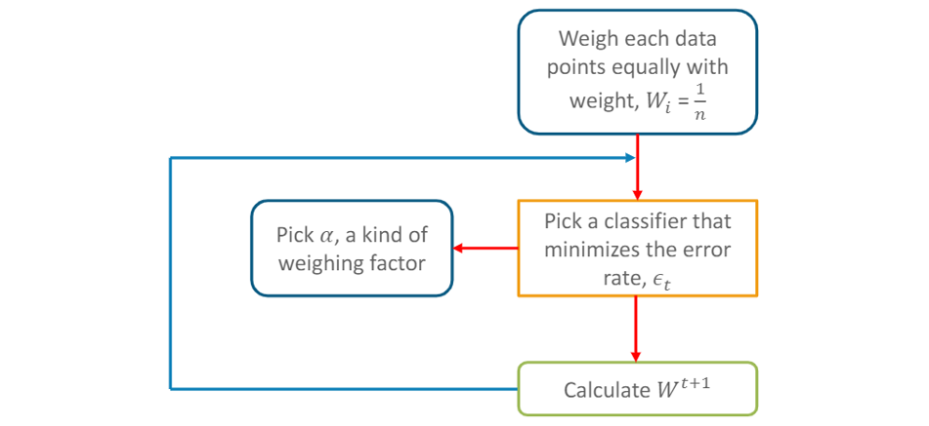
Ada Boost-Flow Chart

Slide 14
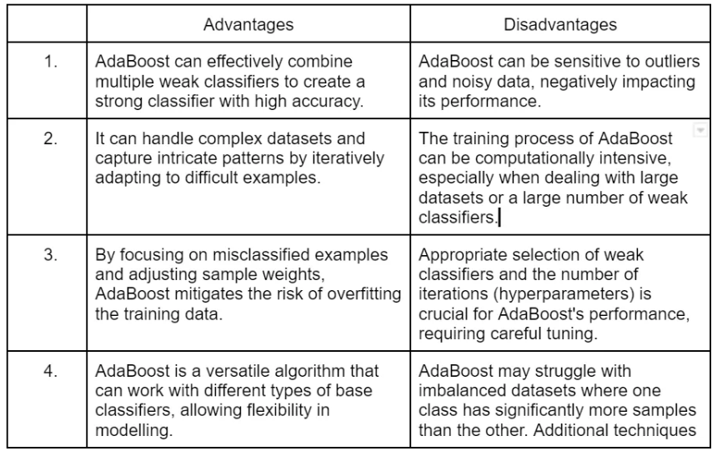
Ada Boost

